Slide 1

Csp 584 – Phase 2 Topic - Home Hub to order/search for services, repairs, tools, etc.
Team Members-
Soham satam
Nishant pathare
Ketan pansare

Slide 2
Progress
Project Skeleton.
Login/Registration Done.
Create User Profile .
Storing Registration data in MySQL.
Dropdown to select from different locations.
Categories of Service Providers.
Displaying technicians present in different locations.

Slide 3
Technologies Used
Front-End : HTML5, CSS 3, Bootstrap, JavaScript, JQuery.
Back-End: Java Servlets, JBC.
Database: MySQL, MongoDB.

Slide 4
Currently working on (this week)
Using Google Maps to identify exact location of the technician.
Working on payment module for the user to make payment online.
Using MongoDB to store reviews and ratings of technicians for better search result in search locations.
Bug Fixes.

Slide 5
Backlogs
Manager Functionality
Technician Login
User can cancel appointments.
Analytics.

Slide 6
Data Format
MYSQL TABLES
Category
City
Order-detail
Professional
Service
User
MongoDB
Technician Rating
Reviews by customers.

Slide 7
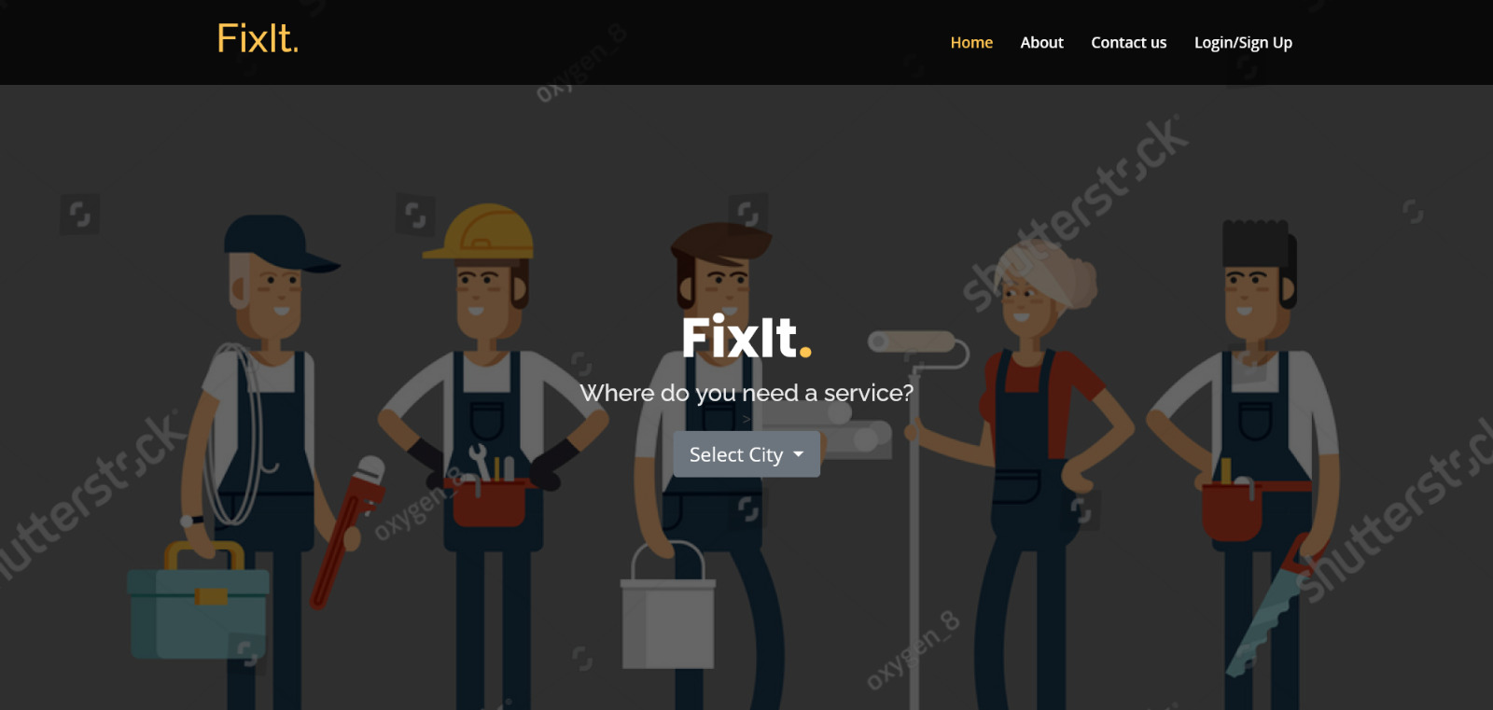
Screenshots

Slide 8
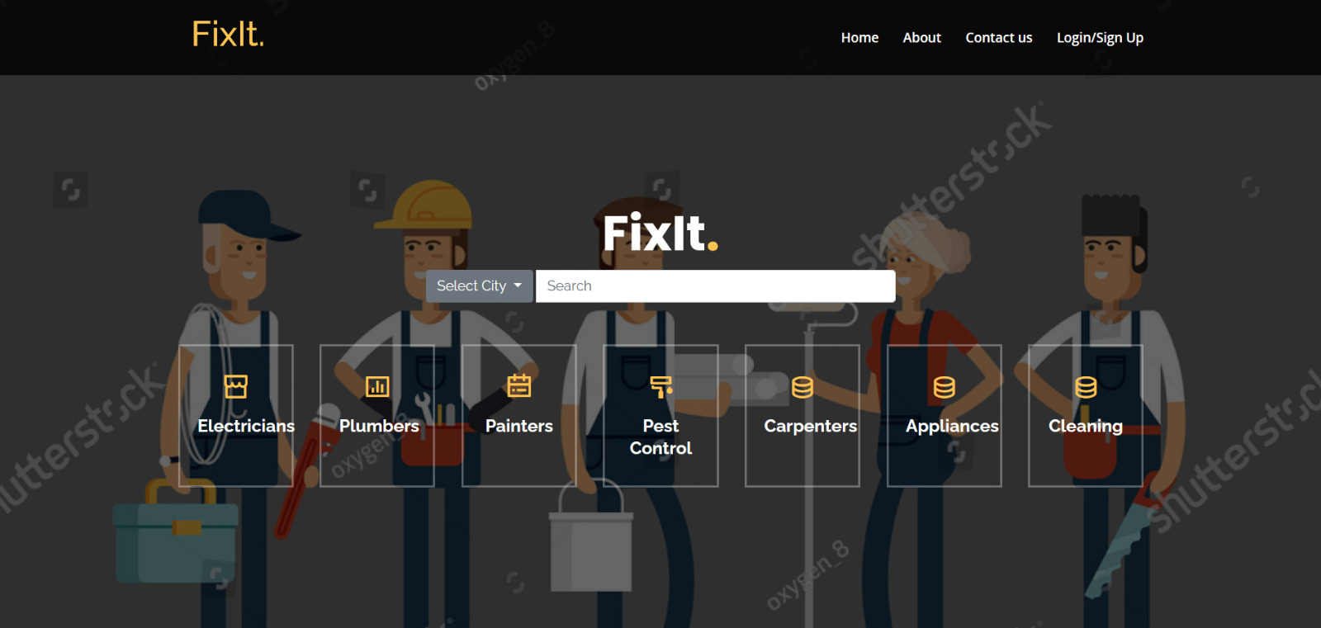
Screenshots

Slide 9
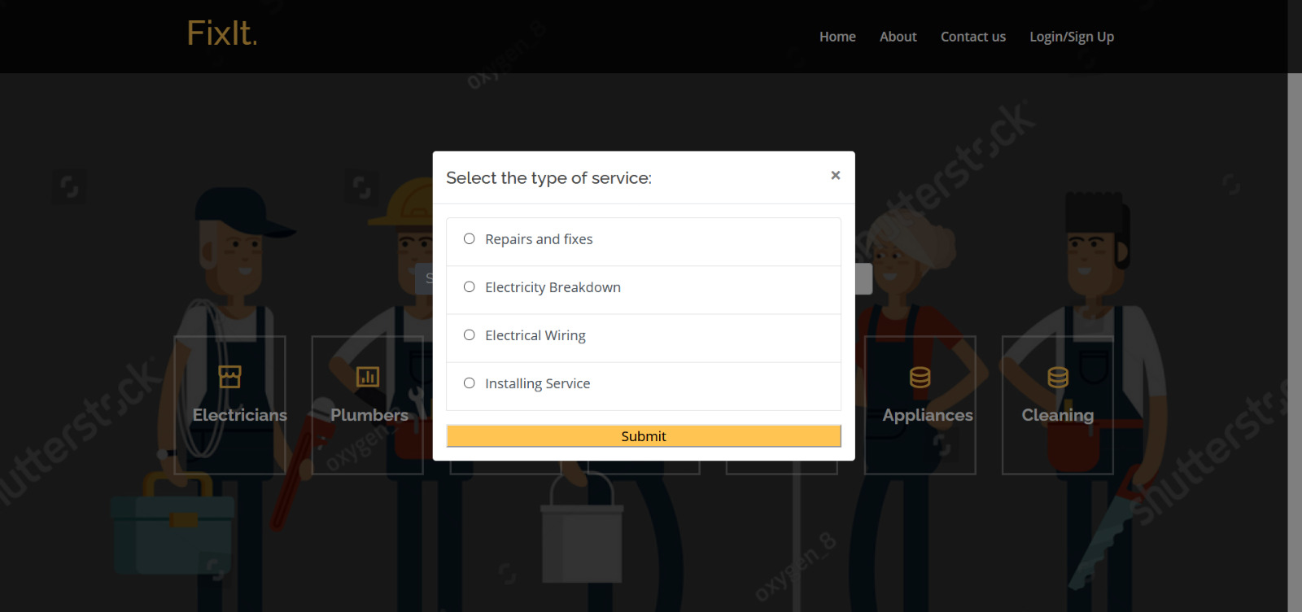
Screenshots

Slide 10
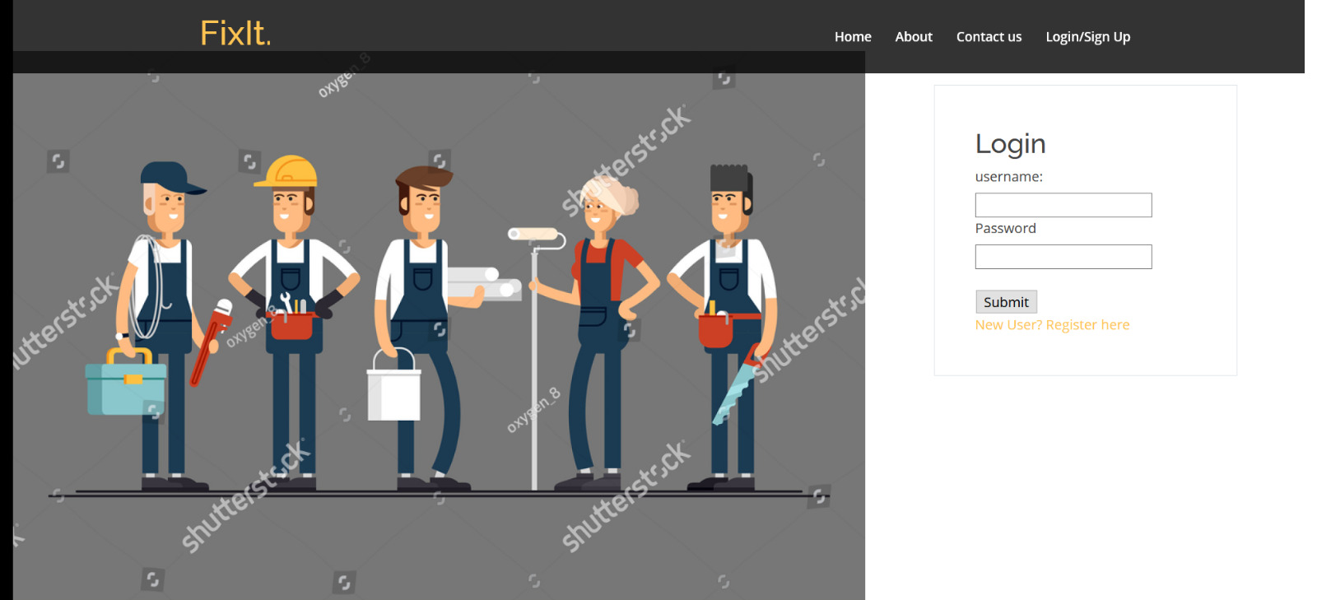




Screenshots

Slide 11
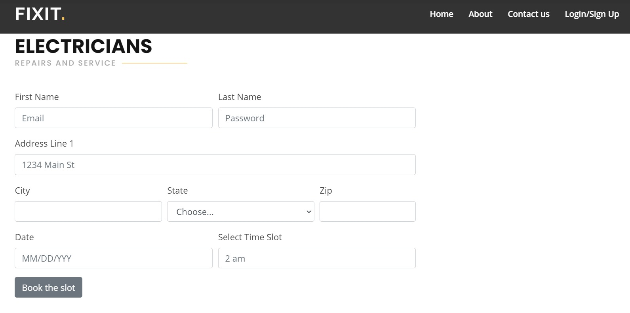
Screenshots

Slide 12
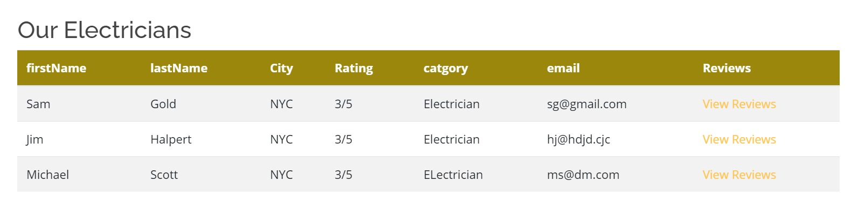
Screenshots

Slide 13
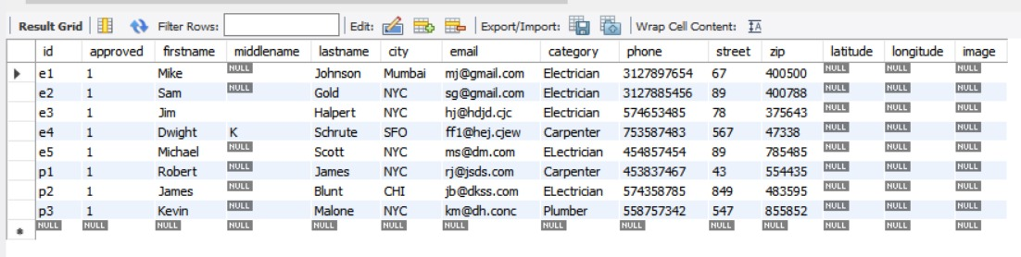
Screenshots

Slide 14
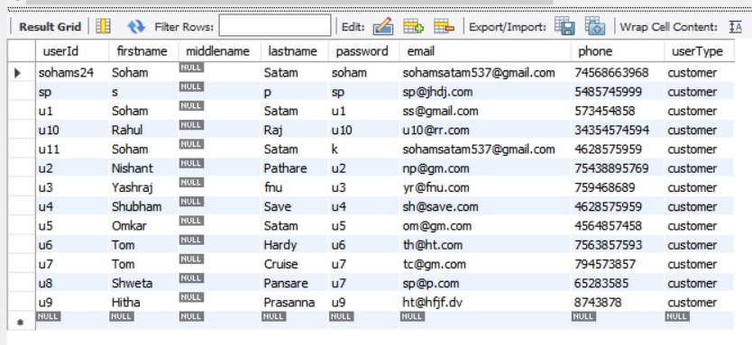
Screenshots

Slide 15
THANK YOU!

